Slide 1

Emulators for Cosmological Parameter Space
Yijie Zhu, Evan Saraivanov, Vivian Miranda
Yang Institute of Theoretical Physics, Stony Brook University
Pasadena, October 2024

Slide 2
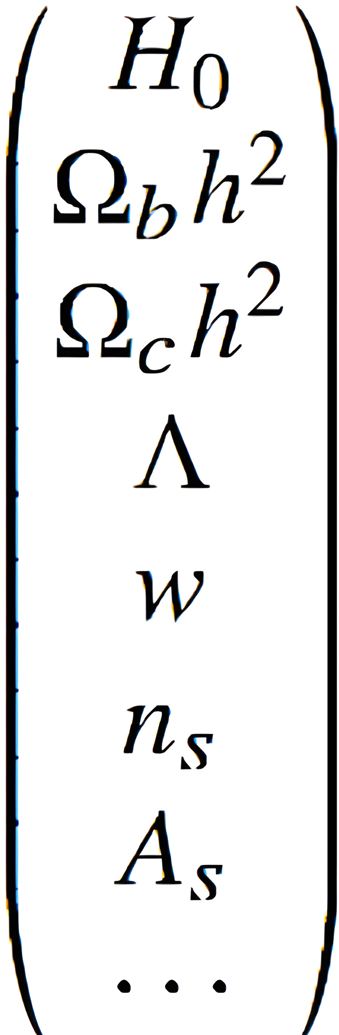
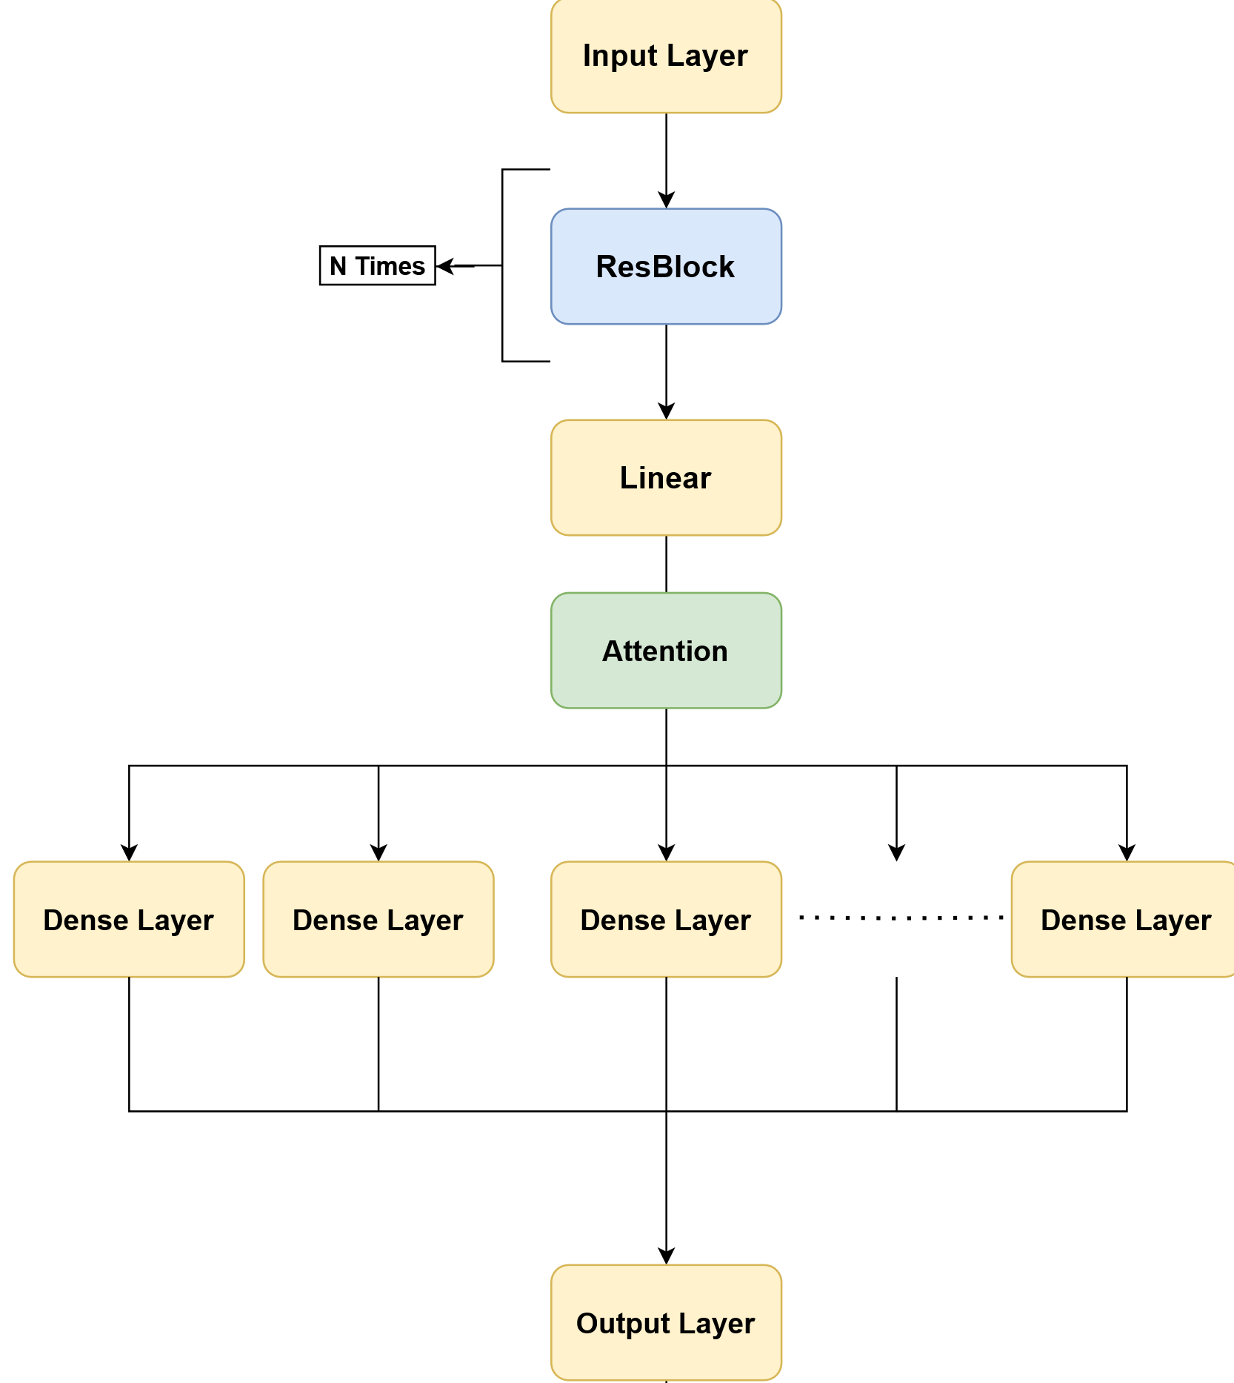
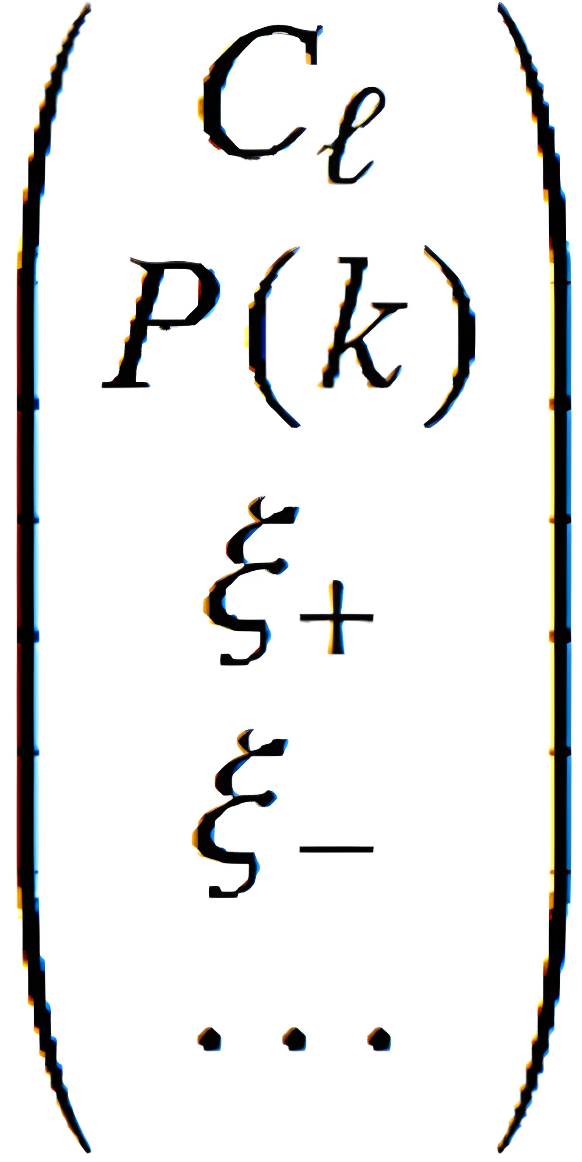
Emulator for Cosmology
Input
Output
Yijie Zhu, Pasadena, October 2024

Slide 3
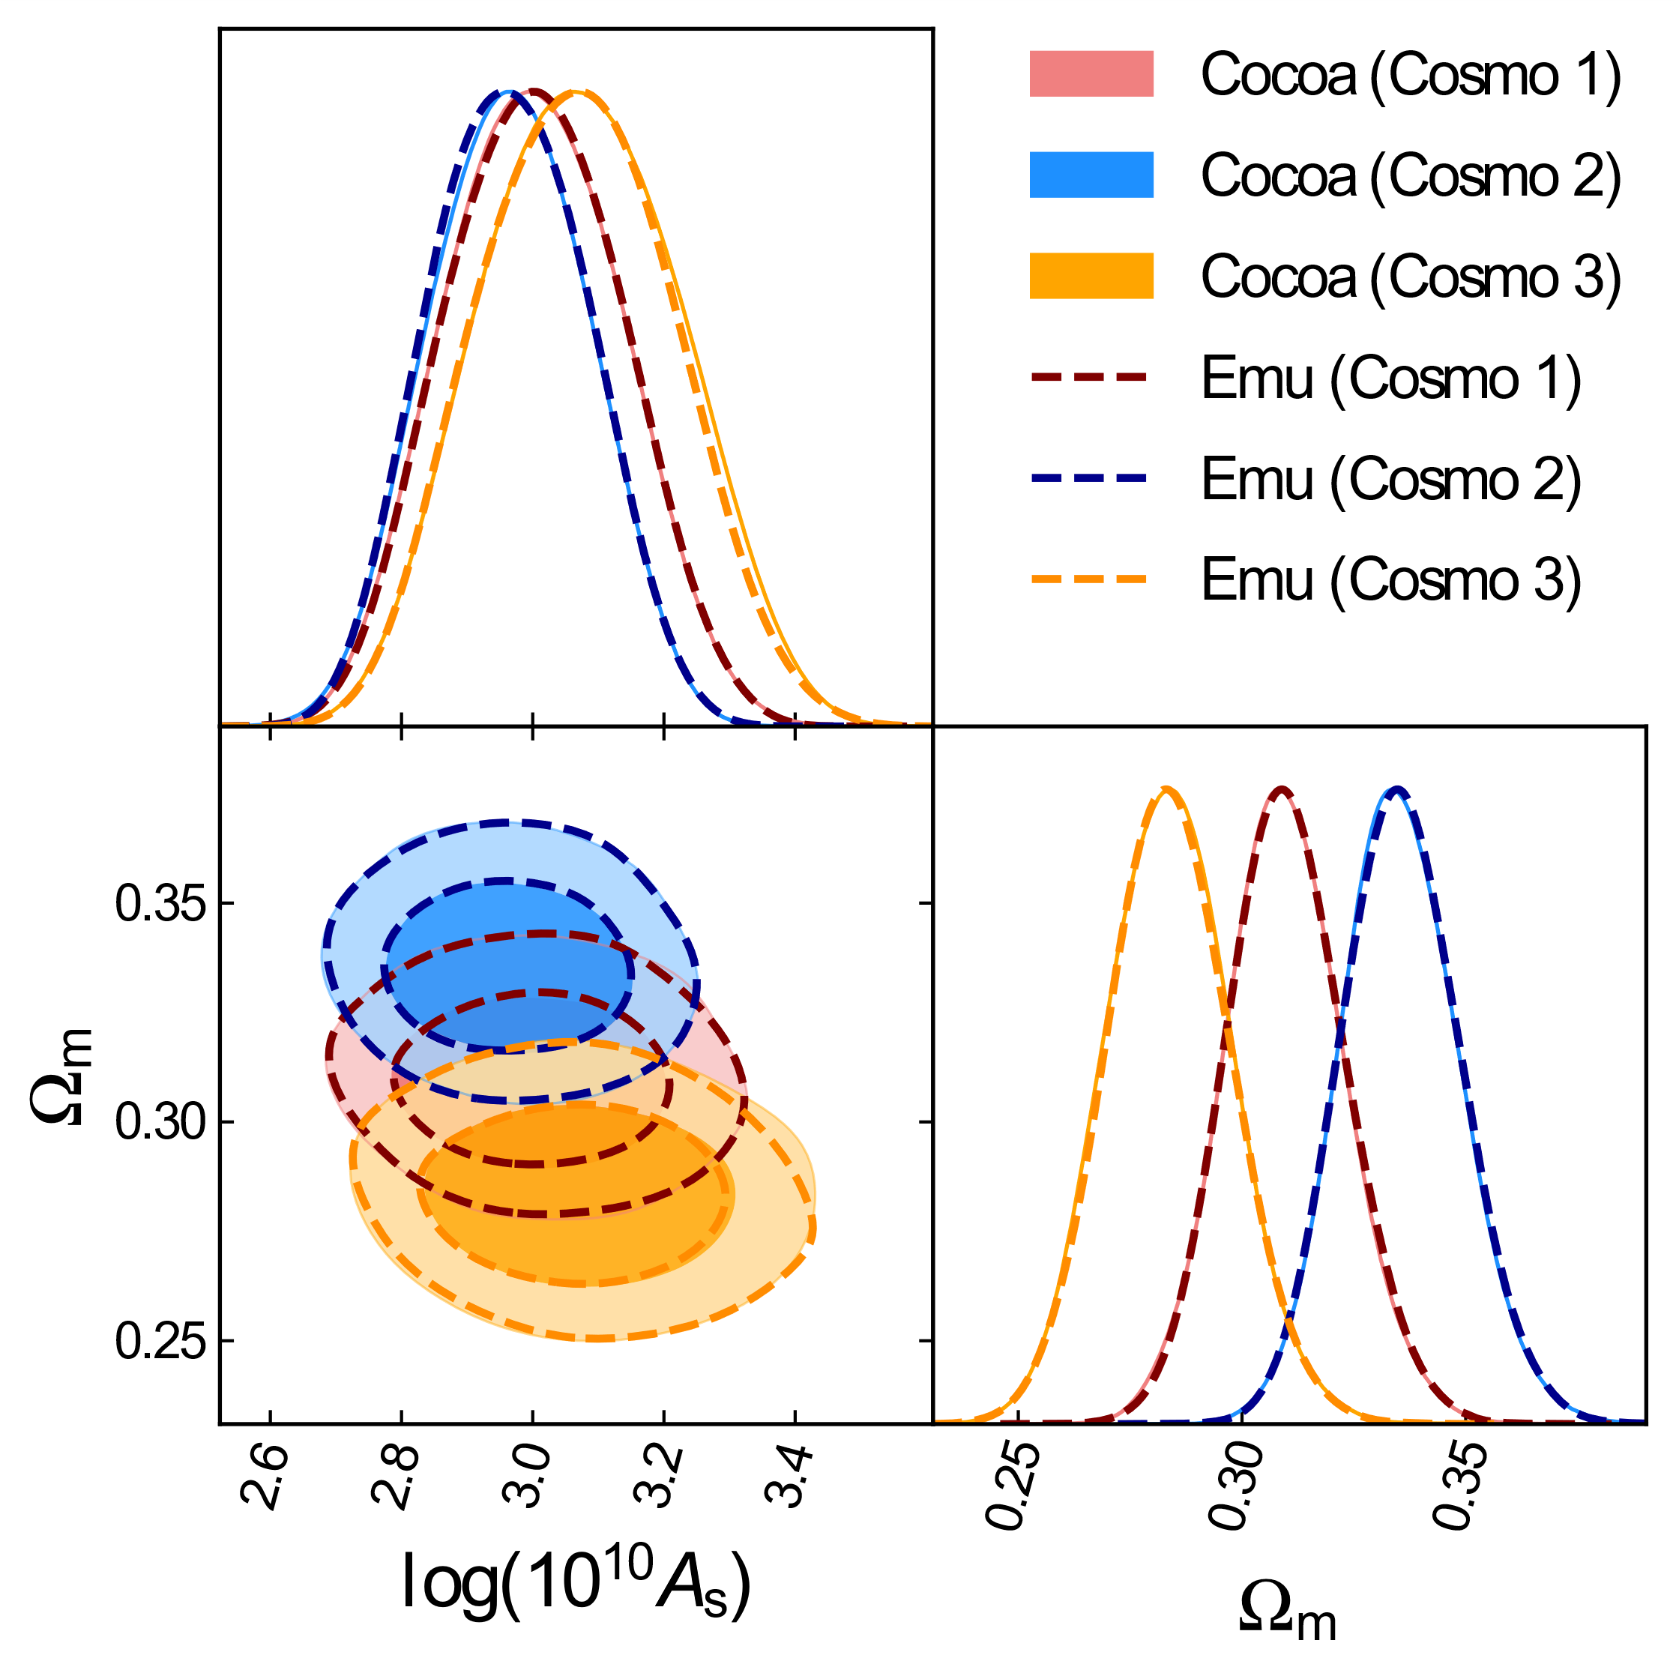
Results on Cosmic Shear (Part II paper)
Main Takeaways
High precision in a large volume in parameter space
Emulator validity does not change if we shift the fiducial point in the chain.
Yijie Zhu, Pasadena, October 2024

Slide 4
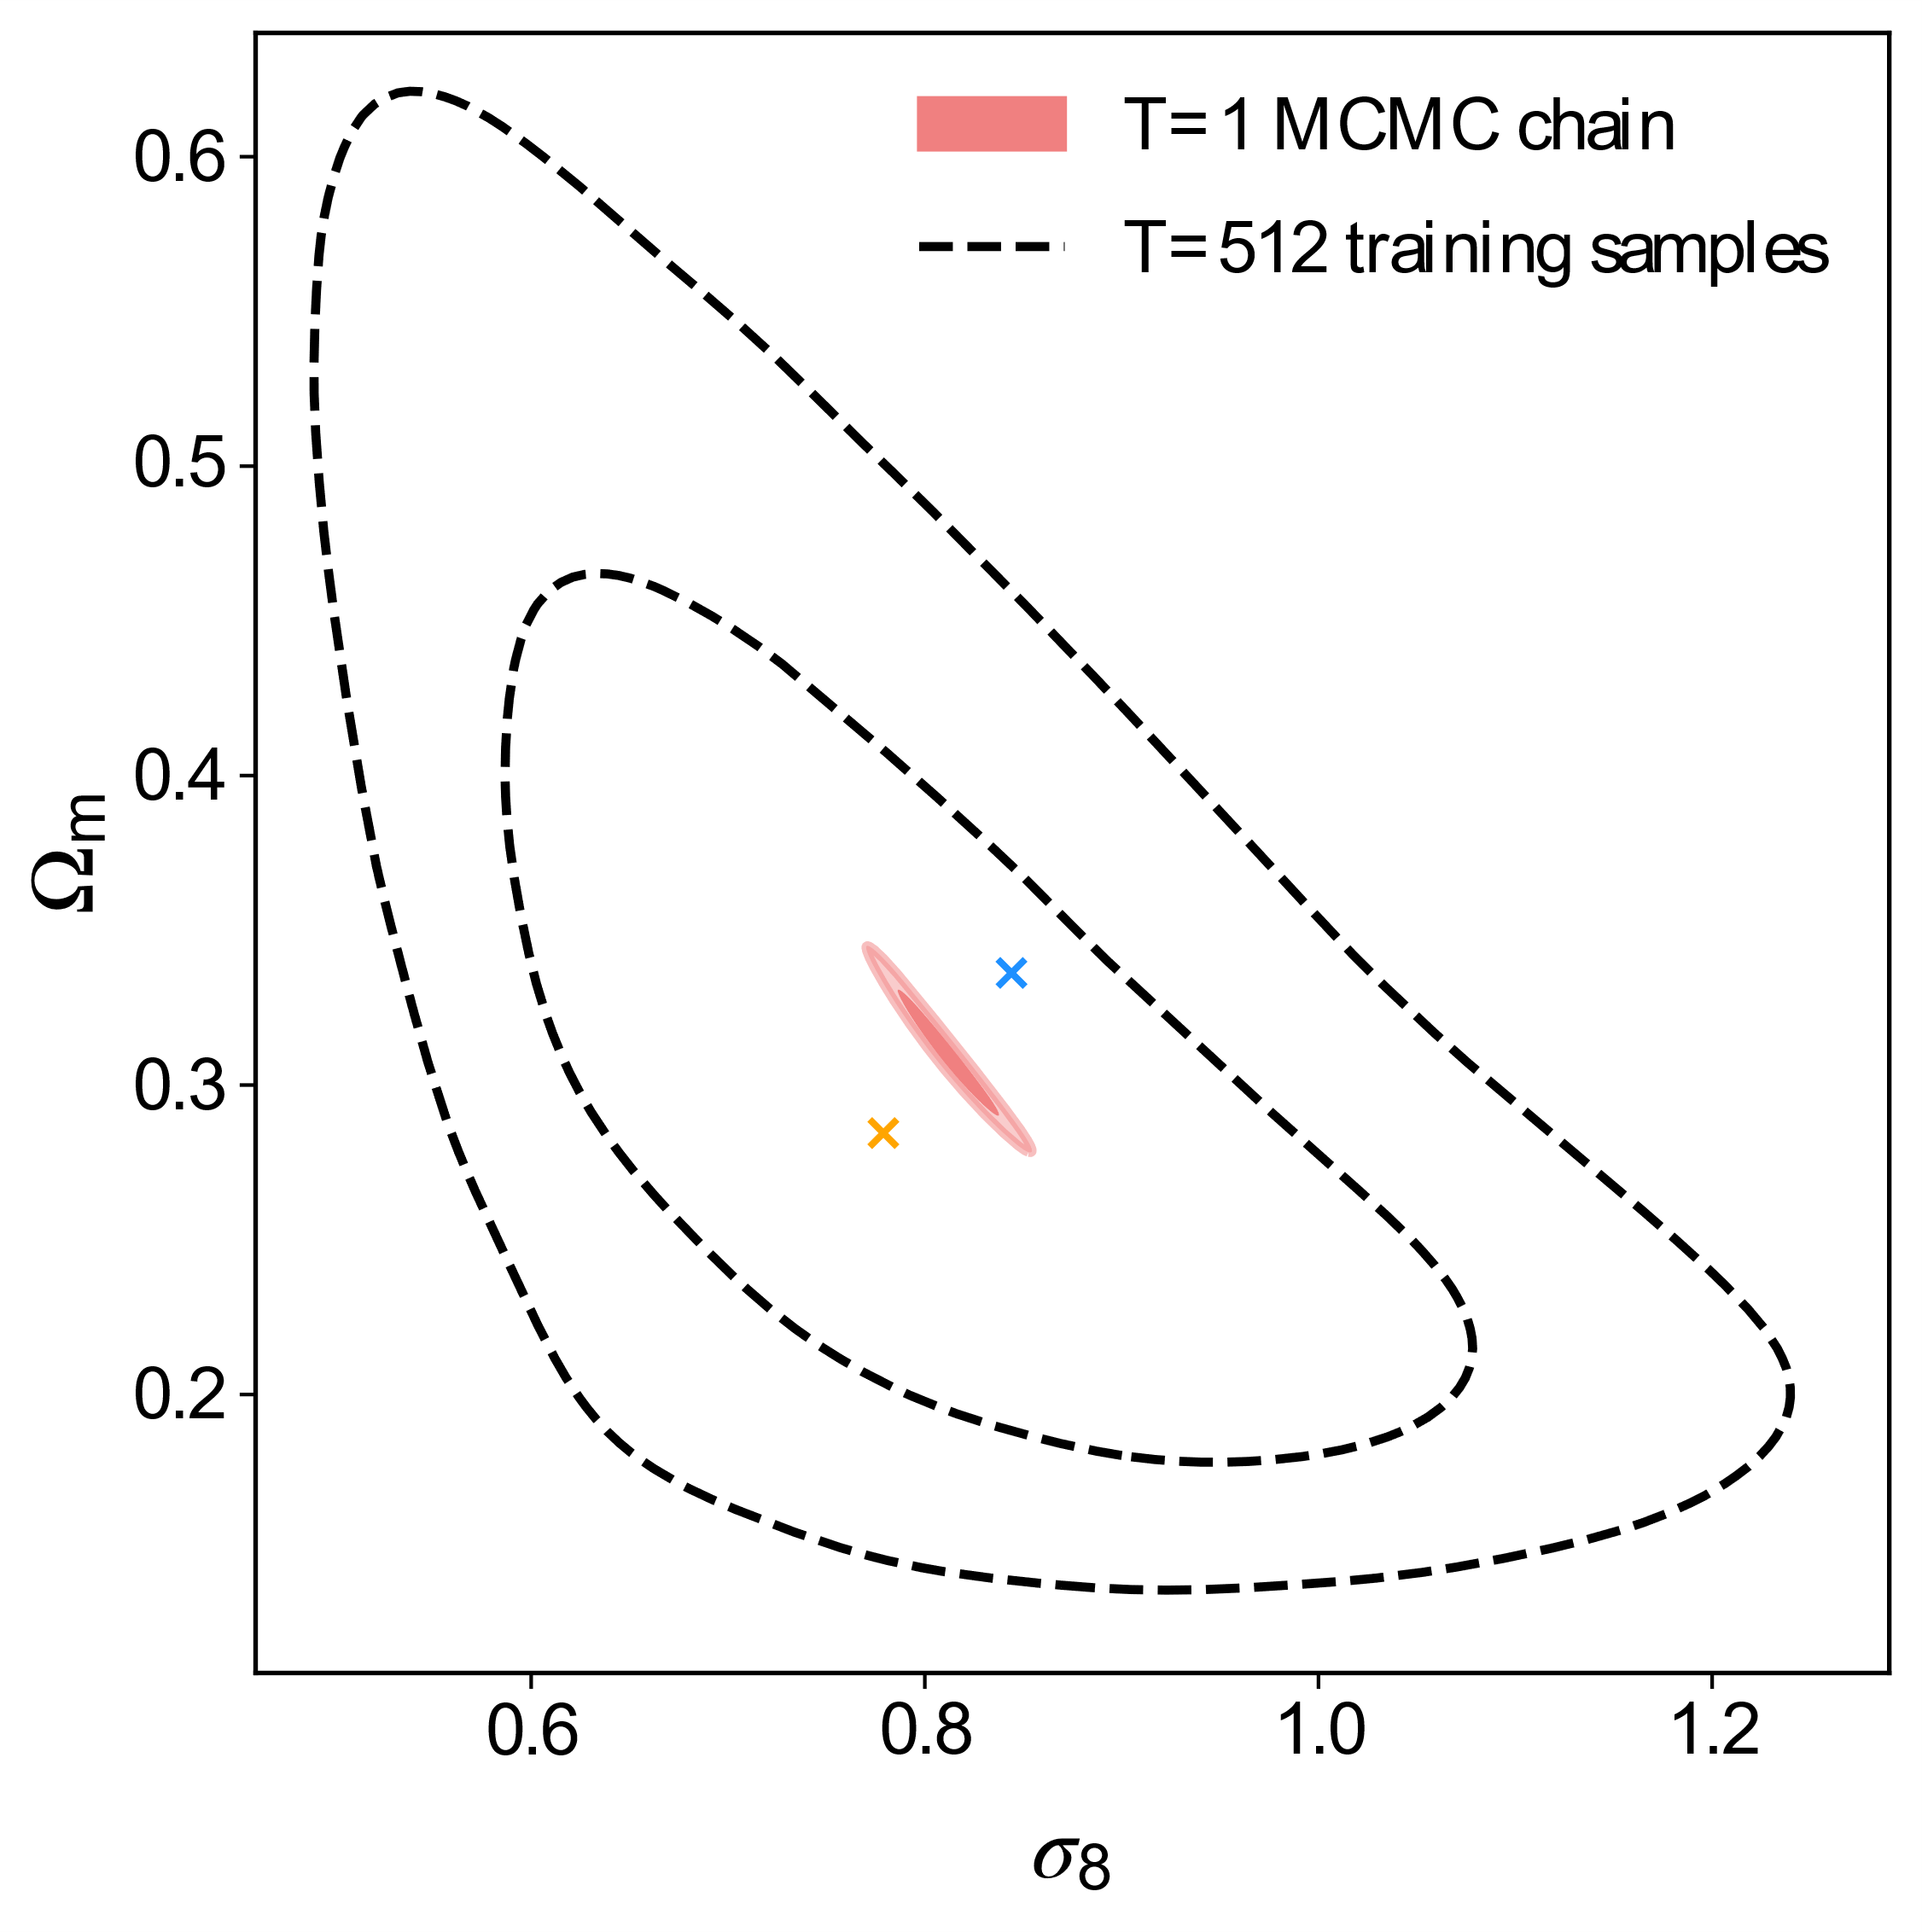
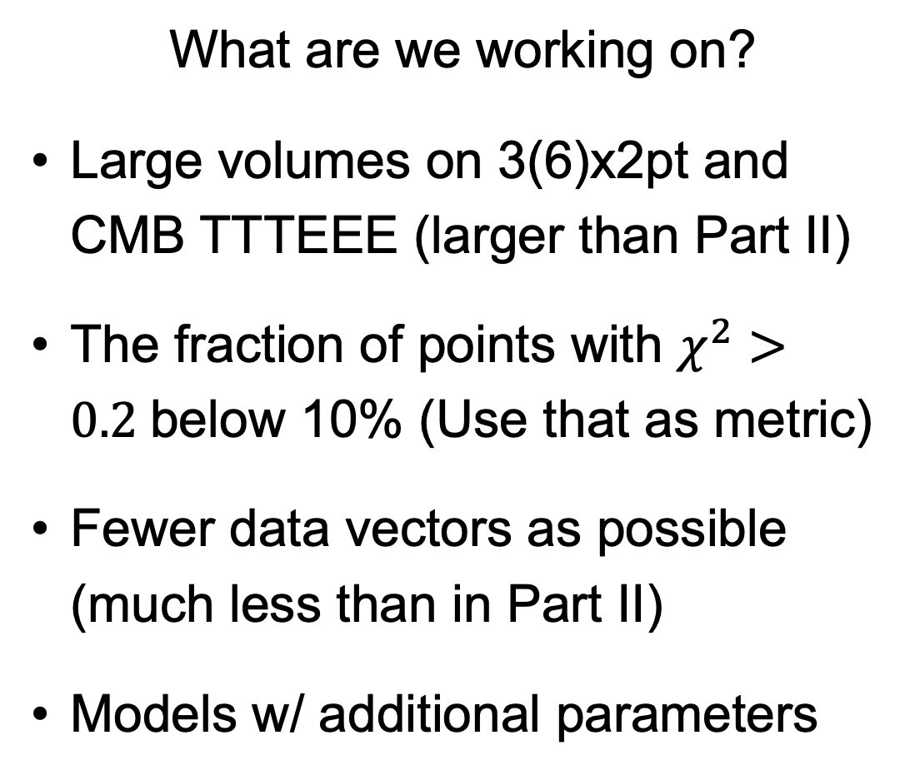
Goal for Part III paper
What are we working on?
Large volumes on 3(6)x2pt and CMB TTTEEE (larger than Part II)
The fraction of points with $χ^{2}>0.2$below 10% (Use that as metric)
Fewer data vectors as possible (much less than in Part II)
Models w/ additional parameters
Yijie Zhu, Pasadena, October 2024

Slide 5
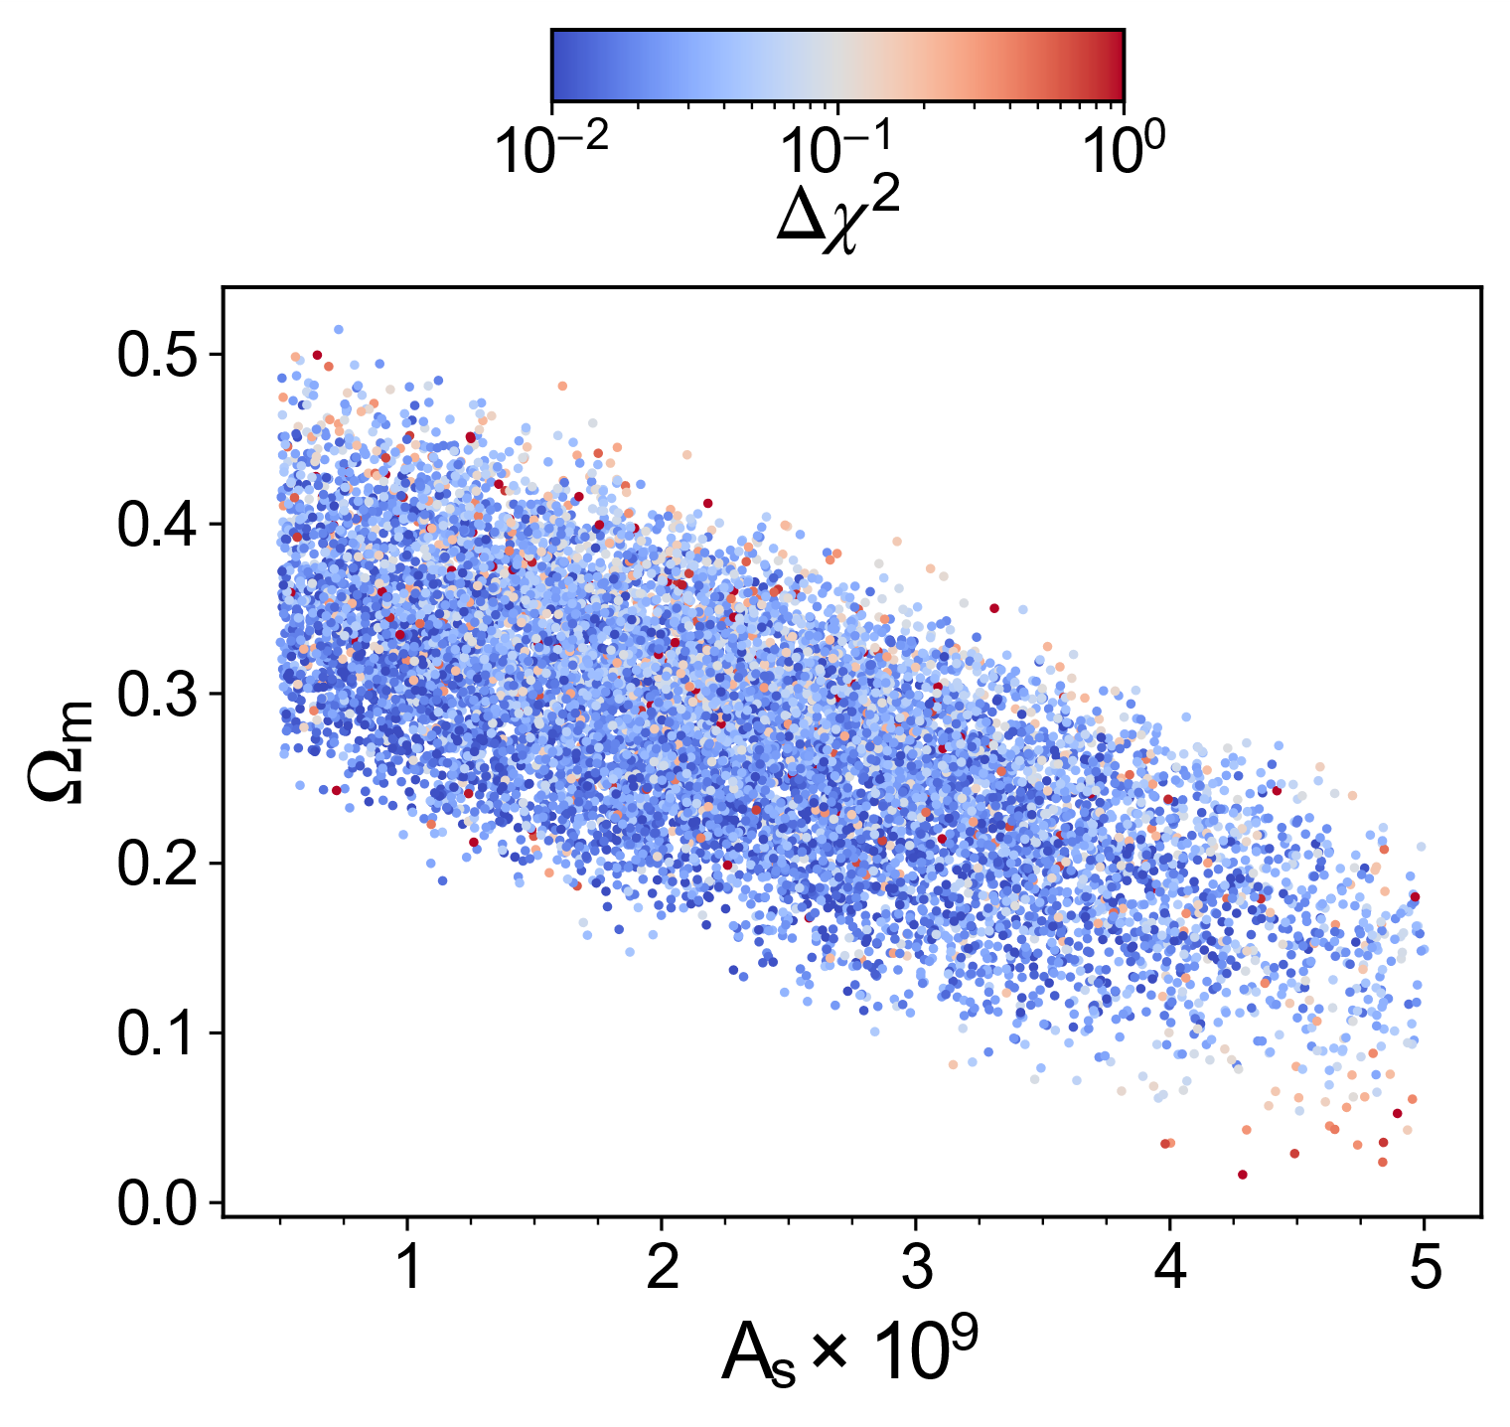
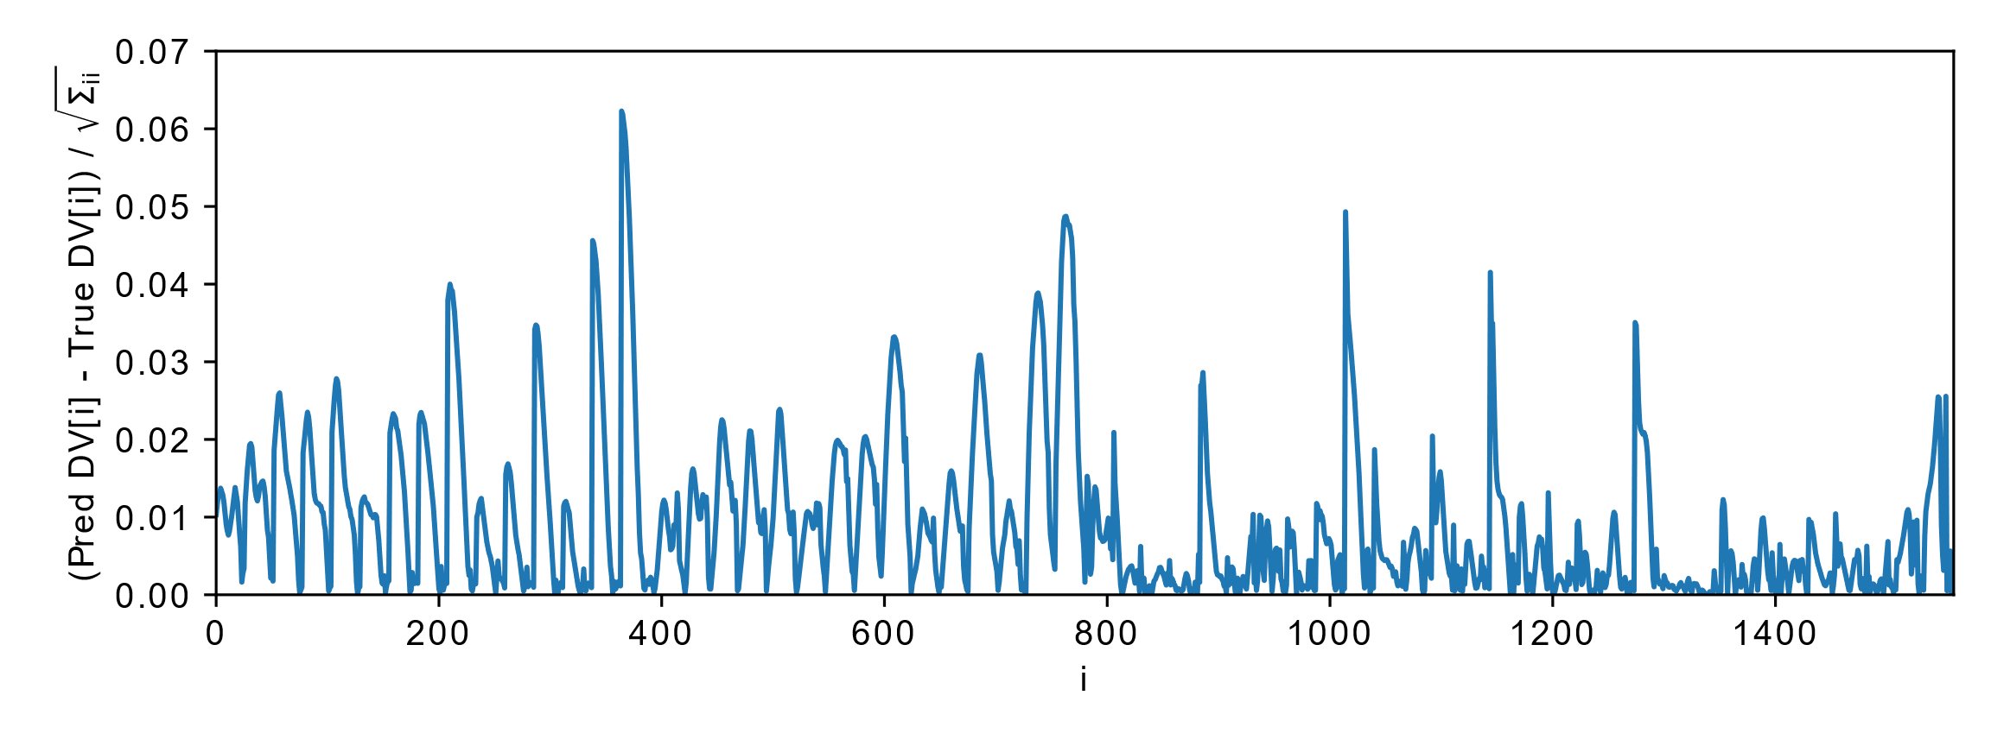
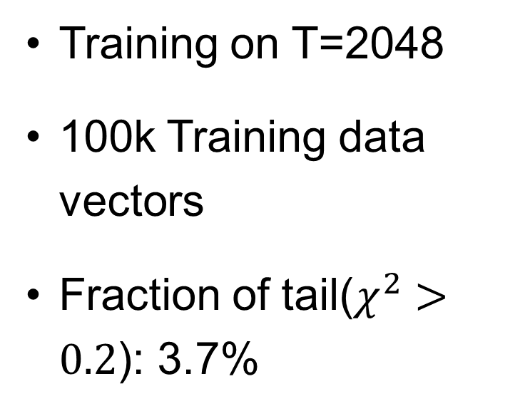
Results for 3x2pt emulator
Training on T=2048
100k Training data vectors
Fraction of tail($χ^{2}>0.2$): 3.7%
Yijie Zhu, Pasadena, October 2024

Slide 6
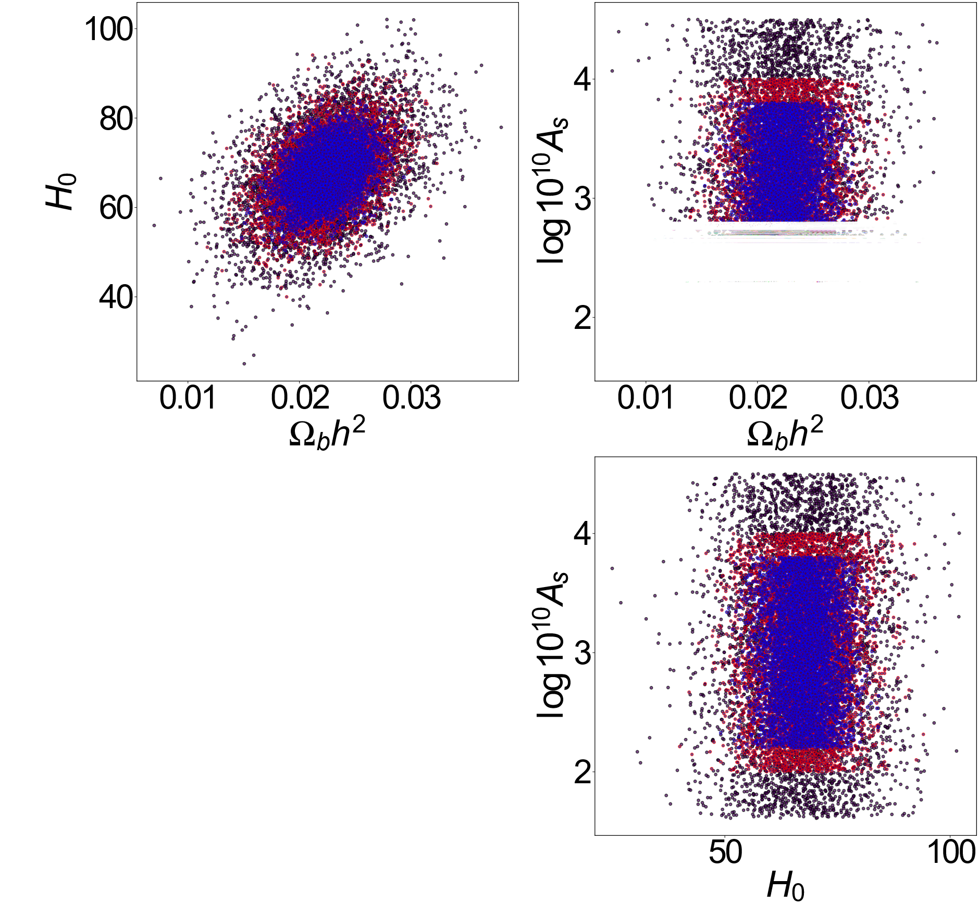
Sampling for CMB emulator
Comparison of Gaussian sampling with different temperatures✢
✢ We applied hard priors in a few directions in parameter space (e.g., As).
Yijie Zhu, Pasadena, October 2024

Slide 7
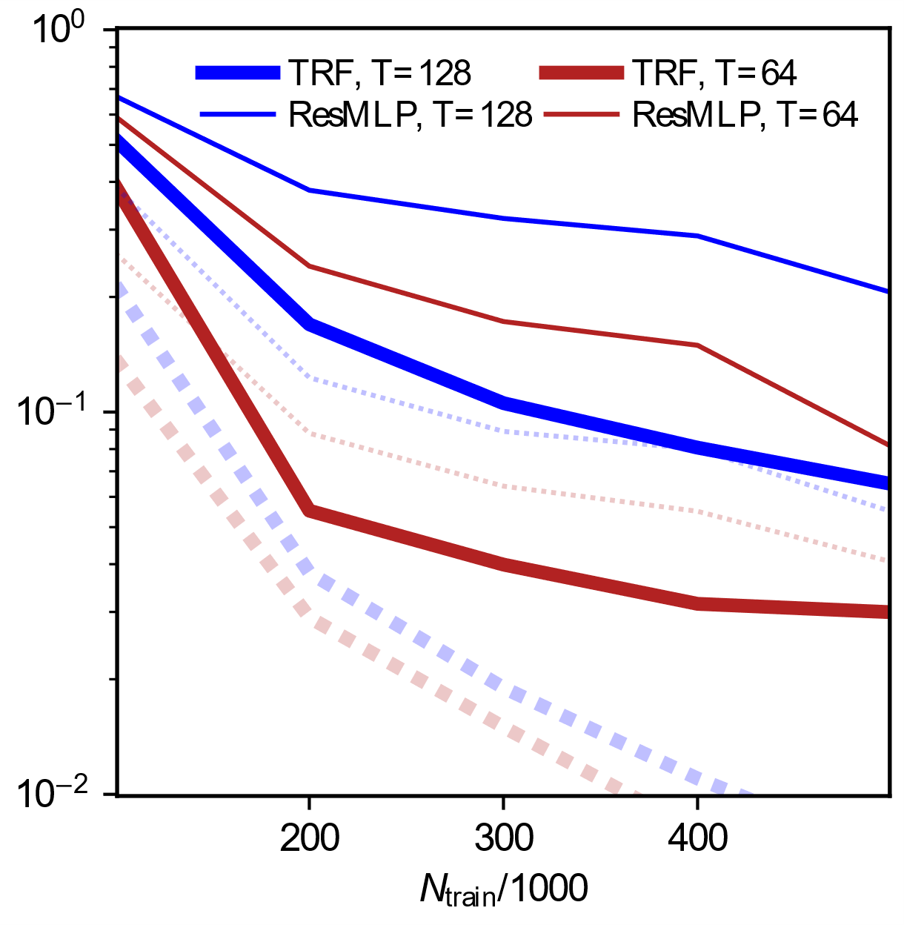
Results for CMB emulator
Training on T=256
TRF needs only 20% of points the ResMLP needs for the same precision
TRF can reach our goal with 500k points
Yijie Zhu, Pasadena, October 2024

